Slide 1
Priority Setting for Health Resource Allocation in Brazil: A Scoping Review and Ethical Analysis
Fábio Ferri-de-Barros, MD, MSC, FSBOT
Clinical Assistant Professor
Department of Surgery
University of Calgary
Director, Pediatric Spine Fellowship
Alberta Children's Hospital
ferridb@ucalgary.ca
November 30, 2015

Slide 2
Acknowledgements
Douglas K. Martin, PhD
Andrew W. Howard, MD, MSc
Jennifer Gibson, PhD
Martin McKneally, MD, PhD (Prof. Emeritus)
Mauricio B. Ferri, MD, MSc

Slide 3
Disclosures
No financial conflicts of interest
Self funded research
Personal experience as a surgeon in Brazil
Motivated this research
Unique perspective for analysis

Slide 4
Introduction-Rationale
Improvement in primary health care (SUS-1988)
Persistent unmet needs and health inequities
The SUS falls short of the intent
(Universality, Integrality and Equity)
Public/Private mix
Fair priority setting: Core health policy challenge in Brazil
(CONASS, 2009, pg. 51; Paim et al., 2011; Ferri-de-Barros et al., 2012)

Slide 5
Ethics of Priority Setting: Critical in LMIC
Scarce resources: Who dies, who lives?
Justice and fairness (Daniels & Sabin, 2008) A4R
A4R Leading framework (empirically applied)
Case study in Tanzania (scaling up antiretroviral treatment)
Case of “Seguro Popular” Mexico (Gonzáles-Pier et a., 2006)
Widely accepted by relevant stakeholders
(WHO, 2006 in Daniels & Sabin, 2008 pg. 202)
Notes:
Epidemiology (prioritize prevalent conditions)
Ethics (Search for fairness and justice of process)
Accountability for Reasonableness (A4R)
(Daniels & Sabin, 1997; Gibson et al., 2002; Martin & Singer, 2003; Gibson et al., 2005a ).
Economics (Search for Cost-effectiveness)
(Donaldson, 1991) PBMA (Mitton & Donaldson, 2004)
Economics & Ethics (Search for Cost-effectiveness with a fair and transparent process)
(Gibson et al., 2006; 2011)

Slide 6
Accountability for Reasonableness (A4R)
Relevance
Publicity
Appeals
Enforcement
Empowerment (Gibson et al, 2005a)
A4R (Daniels & Sabin, 1997)

Slide 7
Methods
Aim
To synthesize current knowledge about ethics of rationing health care resources in Brazil.
Conceptual Framework
Describe, Evaluate and Improve (Martin & Singer, 2003):
Objectives:
I. To describe priority setting (scoping review)
(Arksey & O’Malley, 2005; Levac et al., 2010 )
II. To evaluate priority setting (ethical analysis A4R + E)
(Daniels & Sabin, 1997; Gibson et al, 2005a; Gibson et al, 2011)
III. To improve priority setting
(Recommendations based on I & II)
Notes:
Knowledge synthesis: Scoping studies
Critical step for evidence-informed health policy making (Lomas, 2005; Mays et al., 2005; Arksey & O’Malley, 2005)
Map a complex topic, define research gaps
(CIHR, NIHR in Levac et al., 2010)
1: Identifying the research question (purpose, aim)
2: Identifying relevant studies (two reviewers, breadth/feasibility)
^{3: Study selection (Post hoc)}
4: Charting the data (qualitative content analysis)
5: Collating, summarizing, and reporting results
6: Consultation (optional)- Interest groups
(Arksey & O’Malley, 2005; Levac et al., 2010 )

Slide 8
Methods (Objective I)
Narrative synthesis: Scoping studies
Critical step for evidence-informed health policy making (Lomas, 2005; Mays et al., 2005; Arksey & O’Malley, 2005)
Map a complex topic, define research gaps
(CIHR, NIHR in Levac et al., 2010)

Slide 9
Validity and Sampling
Explicit search strategy
Two independent reviewers (Native speakers)
Documents and Legislations
Interest groups reports
Brazilian studies on ethics of resource allocation
Thematic analysis performed independently
Results tabulated
Themes synthesized by consensus
(Mays et al., 2005; Levac et al., 2010 )

Slide 10
Data extraction sheet
3 most recent National Health Conferences
Conference | Dates/phases | Central theme | Sub themes
Brazilian Studies on Ethics of priority setting
Study | Subject | Objectives | Methods | Conclusions

Slide 11
Results-Objective I (Describe)
7 policy documents (Ministry of Health)
National Health Conferences (CNS)
(By laws and reports of 3 most recent CNS)
3 Reports (interest groups)
World Bank Report (2007)
CONASS report (2009)
Lancet Brazil Working Group (2011)
11 Studies on Ethics of PS in Brazil

Slide 12
National Health Conferences (CNS)
Participants
50% members of the public
25% elected representatives of health professionals
25% elected representatives of managers
Every 4 years, Municipal, State and National levels
Health Policy report sent to the higher level
Health Policies are voted at the federal level

Slide 13
CNS Themes and Sub-themes
Conference | Dates | Central Theme | Sub themes
12th CNS | Municipal State National | Health: A legal right and state duty The health that we have and the SUS that we want | Right to health Social security Participatory management

Slide 14
Studies on Ethics of priority setting in Brazil
Study | Subject | Objectives | Design | Conclusions
Fortes & Zoboli, 2002 | Ethics of resource allocation micro-level | Analyze ethical dilemmas in micro allocation decisions | Individual interviews of 395 random citizens | Deontological and utilitarian values, favoring the destitute
Wendhausen, 2006 | Quality of decision making in a municipal health council | Describe and evaluate the decision making processes | Document analysis, participant observation and individual interviews with key informants | Composition of members does not meet legal requirement, power imbalance

Slide 15
Thematic Analysis
CNS | Societal participation | Integrality Universality Equity | Public/Private mix
Literature | Power Imbalance Council composition Underrepresentation Empowerment | Integrality is challenged Universality accepted Equity endorsed/fairness Explicit process | Inequities/Inefficiencies Lack of PS process for private

Slide 16
Objective 2-Ethical Analysis Extended A4R
Evaluation Checklist (Gibson et al., 2011)
Relevance
Publicity
Appeals
Enforcement
Empowerment (Gibson et al, 2005a)
A4R (Daniels & Sabin, 1997)

Slide 17
Objective II-Ethical analysis
Relevance:
Criteria (decision based on reasons?)
Voted guidelines (Municipal and State levels)
Voted policies (National level) guide allocation decisions
Implicit priority setting
(Fortes, 2008; Ferri-de-Barros et al., 2009)
“To expand oral health coverage” (voted policy)
Outcome: CAD$ 1,000,000,000 to expanding oral health
To what extent?? Integrality principle

Slide 18
Objective II-Ethical analysis
Relevance:
Data (decision based on reasons?)
Policy 7, guideline 2 (pg.21) 14th CNS
Improve decision making based on data
La Forgia & Couttolenc (2007) planning for allocating health resources
“…is conducted mainly as a formal exercise to comply with
the legal requirement rather than as an instrument to implement
policy or as a basis for resource allocation”.
Notes:
(Lack of capacity to generate reliable data)

Slide 19
Objective II-Ethical analysis
Publicity
Transparency-Context, aim, scope and criteria
Guiding themes communicated to the public
Voted guidelines communicated to the public
Voted policies communicated to the public
Reasons for allocation decisions
not communicated to the public
Decisions justifiable based on integrality principle

Slide 20
Objective II-Ethical analysis
Appeals
Voting with broad participation
“SGEP” perfecting participation
(CONASS, 2009 pg.51)
No formal appeal mechanism
Are allocation decisions aligned with voted policies?

Slide 21
Objective II-Ethical analysis
Enforcement/Leadership
Well structured leadership
Legislated framework for leadership
Improved public participation with SUS
Commitment to ethical practices?(CONASS, 2009, pg.39)
Lack of enforcement of legislated principles (Wendhausen, 2007; Martins et al.,2008)

Slide 22
Objective II-Ethical analysis
Empowerment (Gibson et al, 2005a)
Power imbalance among diverse categories of voting participants (knowledge, hierarchical bias, authority) (Wendhausen, 2006; CONASS, 2009, pg.39)
Gap between managers/conferences/councils (CONASS, 2009 pg.51)
Numeric distribution of voting participants does not follow what is prescribed by law (Wendhausen, 2006)
Inequitable voting power in diverse geographic regions
(Ferri-de-Barros, Howard & Martin, 2009)

Slide 23
Good Practices
Broad Social Participation (SUS)
Well defined leadership for the CNS
Voting process at all levels, SGEP
Policies approved during the 14th CNS
Mitigate power imbalances in decision-making
Improve capacity to generate data

Slide 24
Opportunities for Improvement
Legislation is not enforced (Wendhausen, 2006);
Poor planning capacity (rationales)? (La Forgia & Couttolenc, 2007)
Rationales are not publicly available. No appeal-Integrality (Ferri-de-Barros et al., 2009; 2012)
Marked power imbalance (Wendhausen, 2006; CONASS, 2009; Ferri-de-Barros et al., 2009)
Lack of public participation in PS for the private (Ferri-de-Barros et al., 2009; Paim et al., 2011;Ferri-de-Barros et al., 2012).

Slide 25
Discussion
First knowledge synthesis on the topic
Lack of empirical studies about PS in Brazil
Youngkong et al. (2009) “Systematic review” PS LMIC
Mitton et al. (2009) Scoping review on Public participation
Thesis research:
Contributes to the call for action (Victora et al., 2011)
Fills a gap in the international PS literature
WHO acknowledge Brazilian CNS model
(The World Health Report, 2008, pg. 110, in CONASS, 2009, pg. 50)

Slide 26
Limitations
Scoping review (Depth/Breadth)
Complex topic
Macro level Priority Setting
Lack of empirical data (“real world process”)
Qualitative interviews- Portraying (?)
(Kapiriri et al., 2007)
Participant observation- Subjective, Sampling (?)
(Wendhausen, 2006)

Slide 27
Reflexive Account
Improvement of process-improved outcomes
Primary health/social determinants of health
Unmet needs of surgical care
Greater challenge
Health services research (community level)
Elucidate reasons for inequity of outcomes
Empowerment
Capacity building

Slide 28
Objective III- Recommendations
1) Integrality (Fortes, 2009; 2010b; CONASS, 2009; Ferri-de-Barros et al., 2012)
2) Build capacity for planning (La Forgia & Couttolenc, 2007)
3) Empowerment (Wendhausen, 2006; 2007; Martins et al., 2008)
4) Develop explicit rationales/appeals (Ferri-de-Barros et al.,2009)
5) Participation of the private system (Martins et al., 2008 )

Slide 29
Future Challenges
Knowledge translation (consultation)
Stakeholder engagement
Empirical research

Slide 30
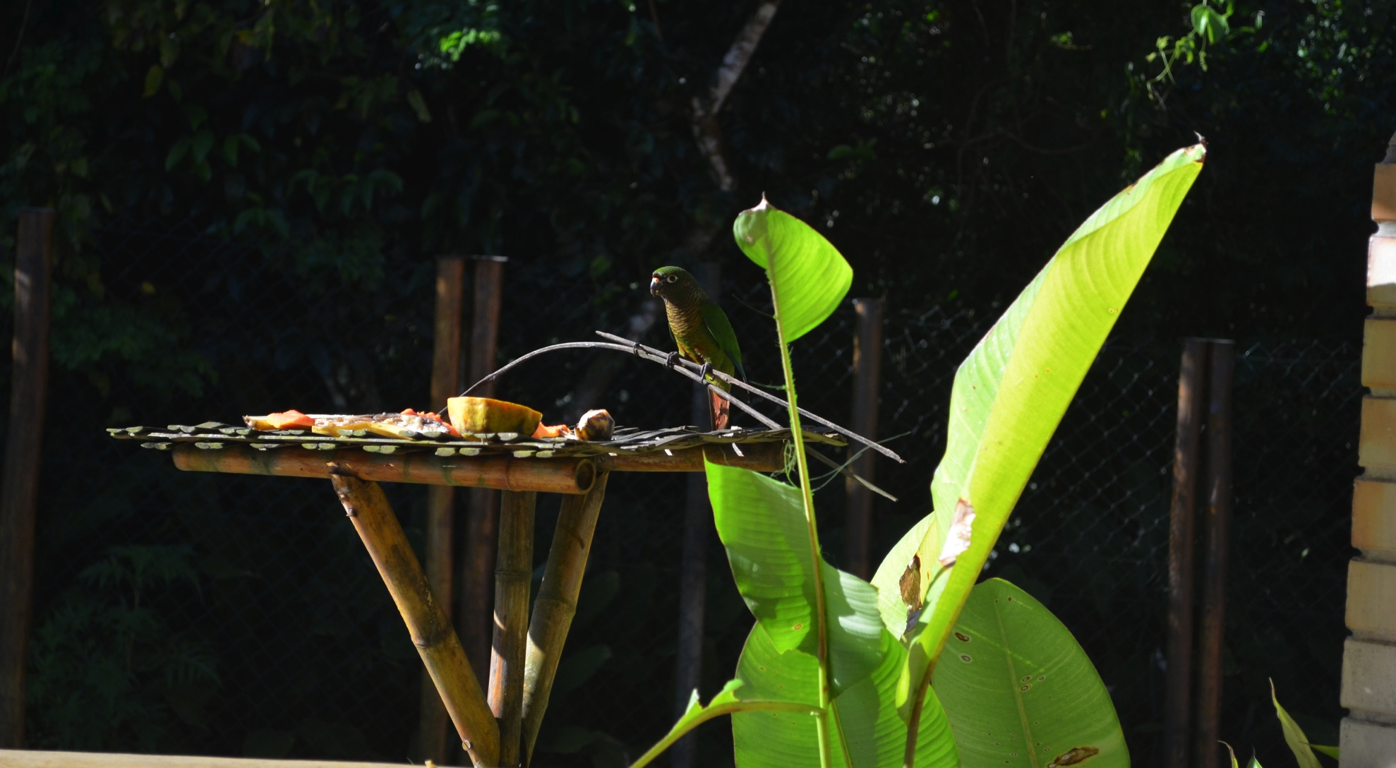
Thank you

