Slide 1
What to buy for UHC? Learning from Health Benefits Policy and Planning in Africa and Asia
IDB CoP on Health Benefits Prioritization and Planning
Webinar
April 29, 2015
Amanda Folsom and Nathan Blanchet

Slide 2
Lessons and examples drawn from:
Joint Learning Network for Universal Health Coverage (JLN)
Practitioner-to-practitioner learning about the practical “how-to’s” of UHC
www.jointlearningnetwork.org
Health Finance and Governance Project (HFG)
USAID global project to support countries in their quest for stronger health systems
https://www.hfgproject.org/

Slide 3
Five framing points
Benefits policy is a means to an end: it’s one part of strategic purchasing toward UHC
Who gets what, and how much?
No country can provide everything to everyone
No “right” answer, only better/worse trade-offs that change over time
Process is vital to combine technical, political, social, and market factors into reasonable policy today, better policy tomorrow

Slide 4
Benefits policy: Means to an end
Means: Benefits policy as part of strategic purchasing
End Goals:
Health status
Financial protection
Financial sustainability
Population satisfaction
Intermediate Progress:
Access
Quality
Equity
Efficiency
Notes:
This illustrates first of five key points. Strategic purchasing is a means to an end, essentially thinking carefully about what to buy, how to buy it, and for whom to buy it to use available resources in best way possible to attain health and financing goals. Benefits policy is a key part of strategic purchasing, focused on what to buy and for whom.

Slide 5
3 questions, many competing forces and answers
Technical
Market
Which services
are covered?
Who is covered?
How much is
covered?
Social
Political
Notes:
Benefits policy is about 3 key questions: which services, who, and how much.
Health and economic technocrats have sometimes dominated benefits policy debates…calculating a feasible and health-maximizing benefits package against a projected budget available to finance that package. However, there are also market, political, and social forces unique to each country that affect how a benefit package is designed and how it performs.
Market forces in health service delivery drives the cost and availability of medical supplies and commodities. Higher cost of care of certain services may mean less resources available to finance the cost of coverage.
Political forces drive which populations are covered, the budget available to finance the scheme, as well as which services are covered depending on national priorities.
Technical considerations involve the data-driven calculations for estimating population risk profiles, population’s predicted utilization of health services, and availability of accurate cost data. These considerations are important to forecast the resources required to administer any benefits package.
Social preferences are also important, and represent what a population/society expects from a health system and benefits policy. Classic case of Oregon’s 1st effort to rationalize Medicaid benefits—population revolted when teeth capping included, appendectomies not on cost-benefits grounds

Slide 6
Tough decisions: What to buy, and for whom?
Key challenges commonly raised among countries of the Joint
Learning Network for Universal Health Coverage (JLN)
When getting started
What to prioritize, and how to decide?
What do services cost, and how to pay for them?
How to ensure HBP is sustainable?
How to assess service readiness?
What primary health care benefits to cover?
How to promote equity and avoid a two-tiered benefits package?
When updating
How to improve financial sustainability?
How to institutionalize an evidence-based process for regular review and updates?
How to engage stakeholders and interest groups?

Slide 7
Prioritization requires making tradeoffs
Provide for more people (with fewer services and financial subsidies) vs. provide more services and/or financial subsidies (for fewer people)
Satisfy immediate political goals vs. ensure sustainability
Respond to competing interests (e.g. interest groups) vs. adhere to values
Rely on cost effectiveness vs. rely on other criteria such as equity or social preferences
Focus on financial risk protection (e.g., through coverage of inpatient services) v. focus on health outcomes (e.g., through coverage of primary health care)

Slide 8
Role of evidence in HBP
The HFG Project is documenting country experiences developing and updating health benefit plans:
Key research questions:
How have governments used evidence in the design and update of HBPs?
How have governments used HBP to promote equity? What was the role of evidence?
How sustainable are the HBPs discussed?
What factors influenced the role that evidence played in the process?
Methods:
Literature review (published and gray literature)
Key informant interviews, primarily through the JLN
Focus on 25 sample countries spanning a diverse range of incomes and geographic locations

Slide 9
Use of evidence in HBP
Limited information in the literature about HBP processes, types of evidence and criteria used
Types of evidence used include:
Cost effectiveness analysis (17 of 25 countries)
Unit cost data (8 of 25 countries)
Capacity assessments (4 of 25 countries)
WHO global guidance on NCDs (e.g., Philippines)
Social preference data (e.g., South Korea)
Factors affecting use of evidence
Time pressures and capacity constraints
Influence of interest groups
Integration of technocrats into political process

Slide 10
Common challenges with use of evidence in HBP
Inadequate capacity and skills
Limited government capacity to use available evidence to support priority-setting process
Data limitations
For example, lack of cost projections, limited supply side capacity assessments, underdeveloped M&E systems
Lack of systematic, evidence-based processes
Under-developed processes for stakeholder consultation and priority-setting
Insufficient sustainability planning
Disconnects between benefits and available budget
Time constraints
Time pressures of reform processes may limit use of evidence and stakeholder engagement
Donor-driven HBP
Narrow focus on evidence based interventions may not account for local context and need. Donors may support HBP design, but not implementation.

Slide 11
Promoting equity in HBP
Key dilemma: Cover more services or cover more people?
South Korea:
Population first – in 1970’s and 80’s rapidly expanded to cover whole population with shallow benefit
Later, in 1990’s and 2000’s, pressure to expand benefit and reduce co-insurance rates
Ethiopia:
Multiple health benefit plans – SHI for formal sector and CBHI for informal sector
Rationale of targeting sub-populations with tailored benefits
But, potential equity concerns
Notes:
Choices about coverage can improve equity or widen inequity. Not uncommon for countries to cover the more privileged first (e.g., the formal sector, civil service, etc.). This is common in a number of African countries --- Ethiopia, Nigeria, Kenya, and a number of francophone countries.

Slide 12
Inequities in HBP in Nigeria
Reality of a two-tiered benefits package
Source: Paul Shaw, for USAID Health Financing Course in Abuja, Nigeria, December 2014

Slide 13
Inequities in PHC Utilization in Nigeria
Use of Primary Maternal and Child Health Services
% Coverage among Lowest and Highest 20% of the Population, Nigeria 2008
Notes:
Children and infants among the poorest 20% of the population are about three times more likely to die than those among the richest 20%.
--This figure summarizes the use of six basic maternal and child health services by economic group (from Nigeria’s 2008 DHS).
--Coverage for each of the six is far higher among the top economic 20% than among the bottom 20%.
--For all but one of the six interventions (medical treatment of fever), coverage among the best-off is twice or more what it is among the poorest.
--In two of the cases (attended delivery and full immunizations) the best-off enjoy a coverage rate over ten times that of the most disadvantaged.
Such disparities are among the largest of those in any of the 50-60 low- and middle-income countries for which data are available!

Slide 14
Thailand’s Path to UHC
Since 2002, all Thais covered by health insurance with access to comprehensive benefits package (as of 2002)
Series of incremental changes to increase coverage and financial risk protection since the 1970’s
Introduction of Universal Coverage Scheme (UCS), a scheme for everybody
Entitles “all Thai citizens to quality health care according to their needs, regardless of their socioeconomic status”
Comprehensive benefit with a PHC focus, to align with existing schemes
Integrated 2 existing publicly subsidized schemes, and enrolled 18 million uninsured in the first year
75% of population covered through UCS and other 25% through a civil service and private employees’ schemes
General tax-financed
Notes:
Before 2000, health coverage was very fragmented in Thailand, with multiple schemes serving different population groups.
The benefits package is available for free at the point of service

Slide 15
Thailand’s equity outcomes
Pro-poor government health subsidies and utilization
Source: Nonthaburi, Thailand: Health Insurance System Research Office, 2012.
Notes:
Benefits-incidence analysis of distribution of Outpatient and Inpatient subsidies by health facility type by wealth quintile (2004)
Net subsidy is difference between unit costs and government subsidy. Unit costs do not vary between the rich and poor; so variation is driven by utilization and OOPs.
Thailand has also seen impressive drops in the incidence of catastrophic health expenditures and medical impoverishment under UCS.

Slide 16
Health benefits policy in Ghana

Slide 17
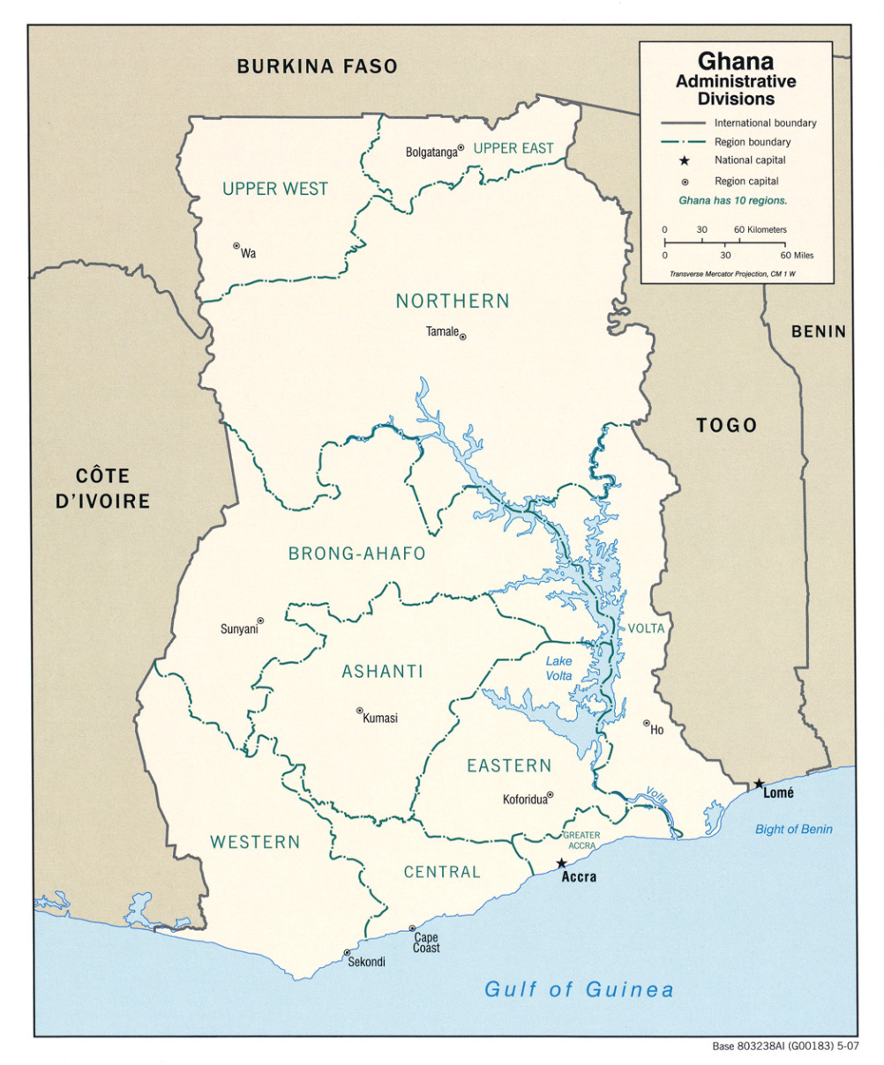
Ghana Health Profile
Population | 25,904,598
GNI per capita (PPP / Current Ex), $US | $3,900 / $1,770
Life expectancy at birth, total (years) | 61
Under-5 Mortality (per 1,000 live births) | 78
Maternal Mortality Ratio (per 100,000 live births) | 380
Prevalence of HIV, % ages 15-49 | 1.3%
Incidence of TB, per 100,000 | 66
Total Health Expenditure per capita (PPP 2011), US$ | $214
Total Health Expenditure, % GDP | 5.4%
Births attended by skilled health personnel, % of all births | 68 (2011)
Physicians per 1,000 population | 0.1 (2010)
Map Source: http://www.lib.utexas.edu/maps/africa/ghana_admin_2007.jpg
Sources: World Bank’s World Development Indicators and WHO’s Global Health Observatory (2013, unless otherwise noted)

Slide 18
Overview of Ghana’s NHIS
One national health insurance scheme for all residents
Standardized, nationally-portable benefits package
No copay fees at the point of service
Delivered by thousands of accredited public and private providers; who
Providers paid from a single national fund
90% of revenues from pre-paid taxes (VAT and payroll);
~5% of revenues from informal sector premiums, but large groups exempted (< 18, >70, pregnant women, indigent)
Political debate over how best to strengthen (not eliminate)

Slide 19
Ghana’s continually evolving benefits policy
1957 independence: Free but limited public; private care out-of-pocket
1970s and 1980s: Increasing reliance on user fees (cash and carry)
1990s: Launch and proliferation of mutual health organizations
Limited, non-portable benefits
Great variation across MHOs – e.g., Nkoranza vs. Okwawuman
2003 and 2012: NHIS enacted and revised – Acts 650 and 852
Quasi-explicit, broad benefits with some exclusions
Nationally portable
Intended to cover “95% of disease conditions”
Important principle: all Ghanaians deserve access to same basic package
2014: Stakeholder dialogue reopens benefits policy debate
Notes:
Who gets what health services and how much has been changing and evolving since 1957 (and before). Change and improvements are necessary and welcome.
Nkoranza benefits: inpatient services at St. Theresa’s, prescriptions not available in hospital, outpatient for snake bites. Premium = 5,000 former Cedis
Okwawuman benefits: inpatient care thru contracts with 2 hospitals, outpatient care above a monetary threshold, cost of cesarian sections; costs of dog, cat, and snake bites, and some referrals outside the scheme’s providers within 1 month of hospitalization. Premium = 15,000 former cedis.

Slide 20
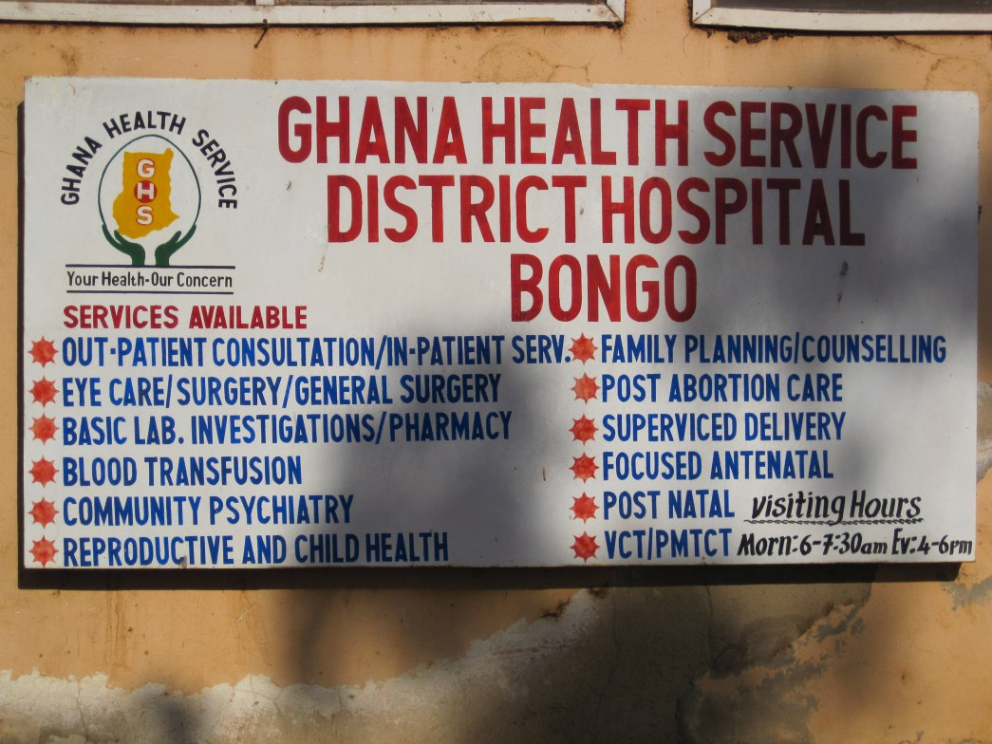
Current NHIS Benefit Policy
Heavy political influence at start of NHIS led to generous and mostly implicit package, broad premium exemptions, and no co-pays
Outpatient services
Inpatient services
Oral health
Maternity care
Emergency care
NHIA Medicines List
Explicit exclusions
Notes:
The NHIS has a generous, expansive benefit package that is set centrally by the NHIA and intended to cover 95% of “disease conditions” in Ghana. It covers: out-patient services, including diagnostic testing operations such as hernia repair; most in-patient services, including specialist care, most surgeries, and hospital accommodation (general ward); oral health treatments; all maternity care services, including Caesarean deliveries; emergency care; and, finally, all drugs on the centrally-established NHIA Medicines List (NHIS 2009). In sum, the NHIS essentially covers all services except very expensive procedures such as certain surgeries, cancer treatments, organ transplants; non-vital services such as cosmetic surgery; and some high profile items such as HIV antiretroviral drugs covered by the National AIDS Control Program.

Slide 21
Challenges to current NHIS benefits policy
1. Major population health problems remain
 | Ghana | LMIC Avg. | WHO/AFRO Avg.
Under-5 Mortality Rate (per 1,000) | 78 | 59 | 90
Maternal Mortality Rate (per 100,000) | 380 | 192 | 500

Slide 22
Challenges to current NHIS benefits policy
2. Theory vs. reality (de jure benefits vs. de facto benefits)
Extremely low health worker to population ratios (10 times fewer physicians than LAC averages), with concentration in major cities
Wide variation in geographic access
Recent comprehensive mapping for PHC capitation package showed severe constraints—only 11% of facilities had HRH necessary to deliver full package

Slide 23
Challenges to current NHIS benefits policy
3. Financial sustainability
Source: www.nhis.gov.gh

Slide 24
Steps to benefits policy reform
Facing financial crisis, NHIS has re-opened debate on benefits, with many steps ahead
Piloting and scale-up of capitation payment for basket of PHC services (2012 to present)
Large stakeholder dialogue (2014) included major issues:
Adherence to referrals and prescriptions
Equity
Matching benefits to available resources
Financial sustainability
Monitoring and evaluation
Donors pressing for priority inclusions such as family planning (ongoing)
All steps driven by ongoing advances in strategic purchasing (capitation, DRG refinements, better M&E, etc.)

Slide 25
General reflections from HFG team for NHIA
Consider “optimal” specification of benefits by the purchaser (NHIA) and how to use other functions and actors (e.g., payment and regulation, provider groups) to define finer details
Use purchasing more effectively to make the benefits package sustainable and help expand population and service coverage over time
Establish a transparent process and criteria for decisions about adding any new benefits
Reassess exemption policies and consider copayments
Track changes to benefits and feed evidence back into the ongoing evolution of benefits policy

Slide 26
Key Take-Away Points and Discussion

Slide 27
Key take-away points
HBP is a key lever to improve population health, equity, and sustainability
HBP is one part of strategic purchasing for UHC: Requires deciding what services to purchase, who will provide them, and how providers will be paid.
Defining and updating HBP requires (1) quality information, (2) capacity to analyze and use information; and (3) transparent, evidence-based process
Contents of benefits package should be determined by a combination of factors
Epidemiology, cost-effectiveness, equity considerations, service capacity, consumer preference, and political viability
Attention to the needs of the poor and most vulnerable is essential in designing an equitable HBP
Notes:
Similarities with LAC:
--Similar concerns: sustainability, population health status, equity
--Benefits policy as a key lever to address these concerns
--Importance of process – more than a technical issue; it’s also political
--De facto rationing as a product of resource constraints
--Lots of desire for more evidence-based policymaking
--Benefits policy should be one part of strategic purchasing; don’t want to separate too much
Differences:
--Single benefits package or multiple? Fragmentation in LAC
--LAC constitutional right to health (not necessarily the case in other places)
--LAC countries may get more lobbying from pharma, devices, etc. than African countries
--Epi transitions – key NCD issues in LAC, becoming bigger issue in Africa and Asia
--Variation in explicit v. implicit definitions of benefits

Slide 28
Discussion questions
What is similar and different about HBP in the LAC region?
Potential similarities:
Similar concerns about population health, sustainability, equity
Importance of process and political realities
De facto rationing as byproduct of resource constraints
Importance of strategic purchasing reform alongside benefits policy change
Potential differences:
More historically-entrenched segmentation of benefits in LAC?
Stronger constitutional rights to health in LAC = more litigation?
Further along in epidemiological transition to chronic diseases?
And we’d love to hear: What should our Joint Learning Network’s PHC initiative focus on for PHC-related benefits policy?
Notes:
Similarities with LAC:
--Similar concerns: sustainability, population health status, equity
--Benefits policy as a key lever to address these concerns
--Importance of process – more than a technical issue; it’s also political
--De facto rationing as a product of resource constraints
--Lots of desire for more evidence-based policymaking
--Benefits policy should be one part of strategic purchasing; don’t want to separate too much
Differences:
--Single benefits package or multiple? Fragmentation in LAC
--LAC constitutional right to health (not necessarily the case in other places)
--LAC countries may get more lobbying from pharma, devices, etc. than African countries
--Epi transitions – key NCD issues in LAC, becoming bigger issue in Africa and Asia
--Variation in explicit v. implicit definitions of benefits

