Slide 1




How to increase the impact of heath benefits plans?
The Armenian example
Nicole Fraser & Adanna Chukwuma
9th March 2022

Slide 2
ACKNOWLEDGEMENTS
Ministry of Health of Armenia: Lena Nanushyan, Lusine Qocharyan, Lusine Avalyan, Qnar Ghonyan, Liana Barseghyan, Nune Pashayan, Tsaghkanush Sargsyan
State Health Agency: Tsaghik Vardanyan, Lusine Yengibaryan, Garush Ayvazyan
National Institute of Health: Alexander Bazarchyan, Diana Andreasyan, Anastas Aghazaryan, Naira Davtyan
Health Project Implementation Unit: Yervand Elibekyan, Anna Lalayan
Global Fund Project Coordination Team: Hasmik Harutyunyan, Kristina Khachatryan, Lilit Khachatryan, Gayane Sahakyan
World Bank Team members/ co-authors: Marianna Koshkakaryan, Lusine Yengibaryan, Xiaohui Hou, Tommy Wilkinson.
World Bank: Sylvie Bossoutrot, Tania Dmytraczenko, Toomas Palu, Denizhan Duran, Arpine Azaryan, Lilit Simonyan, Fenya Epremyan
Funding: Gavi, The Vaccine Alliance; The Global Fund to Fight AIDS, Tuberculosis and Malaria; Bill and Melinda Gates Foundation

Slide 3

Outline for the talk
Rationale of the study in the Armenia context
Selected technical HIPtool application challenges and solutions
Results from the optimization of resource allocations for Essential UHC interventions
Conclusions, lessons and reflections

Slide 4
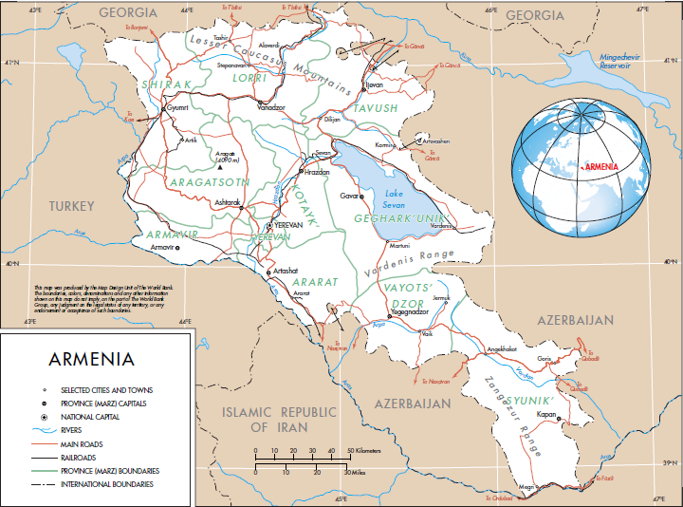
Armenia is an upper-middle-income country in the South Caucasus Region
2.97M population, rapidly increasing 65+ group
Upper middle-income with a Gross National Income of ~ USD 4,200 per capita

Slide 5
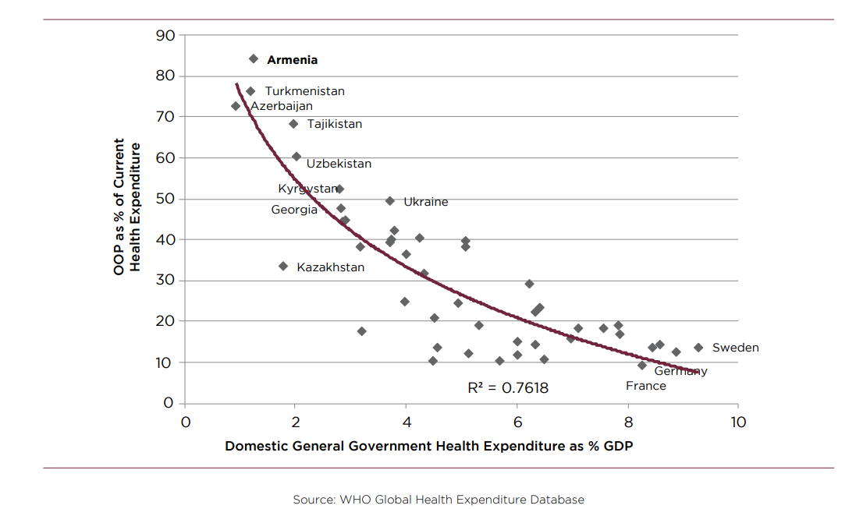
Armenia suffers from low public health spending and below-average health outcomes
Higher than average risk of premature NCD death
Health care is predominantly financed out-of-pocket
Source: World Health Organization, 2019
Source: World Health Organization, 2019
Since 1997, Armenia has had an explicit health benefits package (HBP) specifying services, groups and tariffs
However, essential services are excluded, with low reimbursement rates due to underfinancing of health in the budget
The country proposes to undertake UHC reforms, including the expansion of benefits coverage

Slide 6
Current leading causes of morbidity and premature mortality
PROJECTION TO 2030
Leading causes for morbidity and pre-mature mortality remain similar:
Ischemic heart disease
Stroke
Diabetes
Tracheal/bronchus/ lung cancers
Low back pain
Neck pain
Major depressive disorders
Migraine
Anxiety disorders
Alcohol use disorders
Dietary iron deficiency
Falls
Hearing loss
Tooth loss
Ischemic heart disease
Ischemic stroke
Intracerebral hemorrhage
Alzheimer’s disease
Lung cancer
Breast cancer
Stomach cancer
Colorectal cancer
Lower respiratory infection
Self harm
Type 2 diabetes
COPD
Pre-mature death (YLL)
Disability (YLD)
Sources: : IHME GBD visualizations
http://vizhub.healthdata.org/gbd-compare/ & https://vizhub.healthdata.org/gbd-foresight/

Slide 7

Non-communicable diseases largest and fastest growing spending category
PERCENT = INFLATION-ADJUSTED SPENDING CHANGES 2014 TO 2018
Spending by disease group, AMD millions
Sources: MOH NHA Report 2018; MOH (2020) NHA 2018 data tables

Slide 8
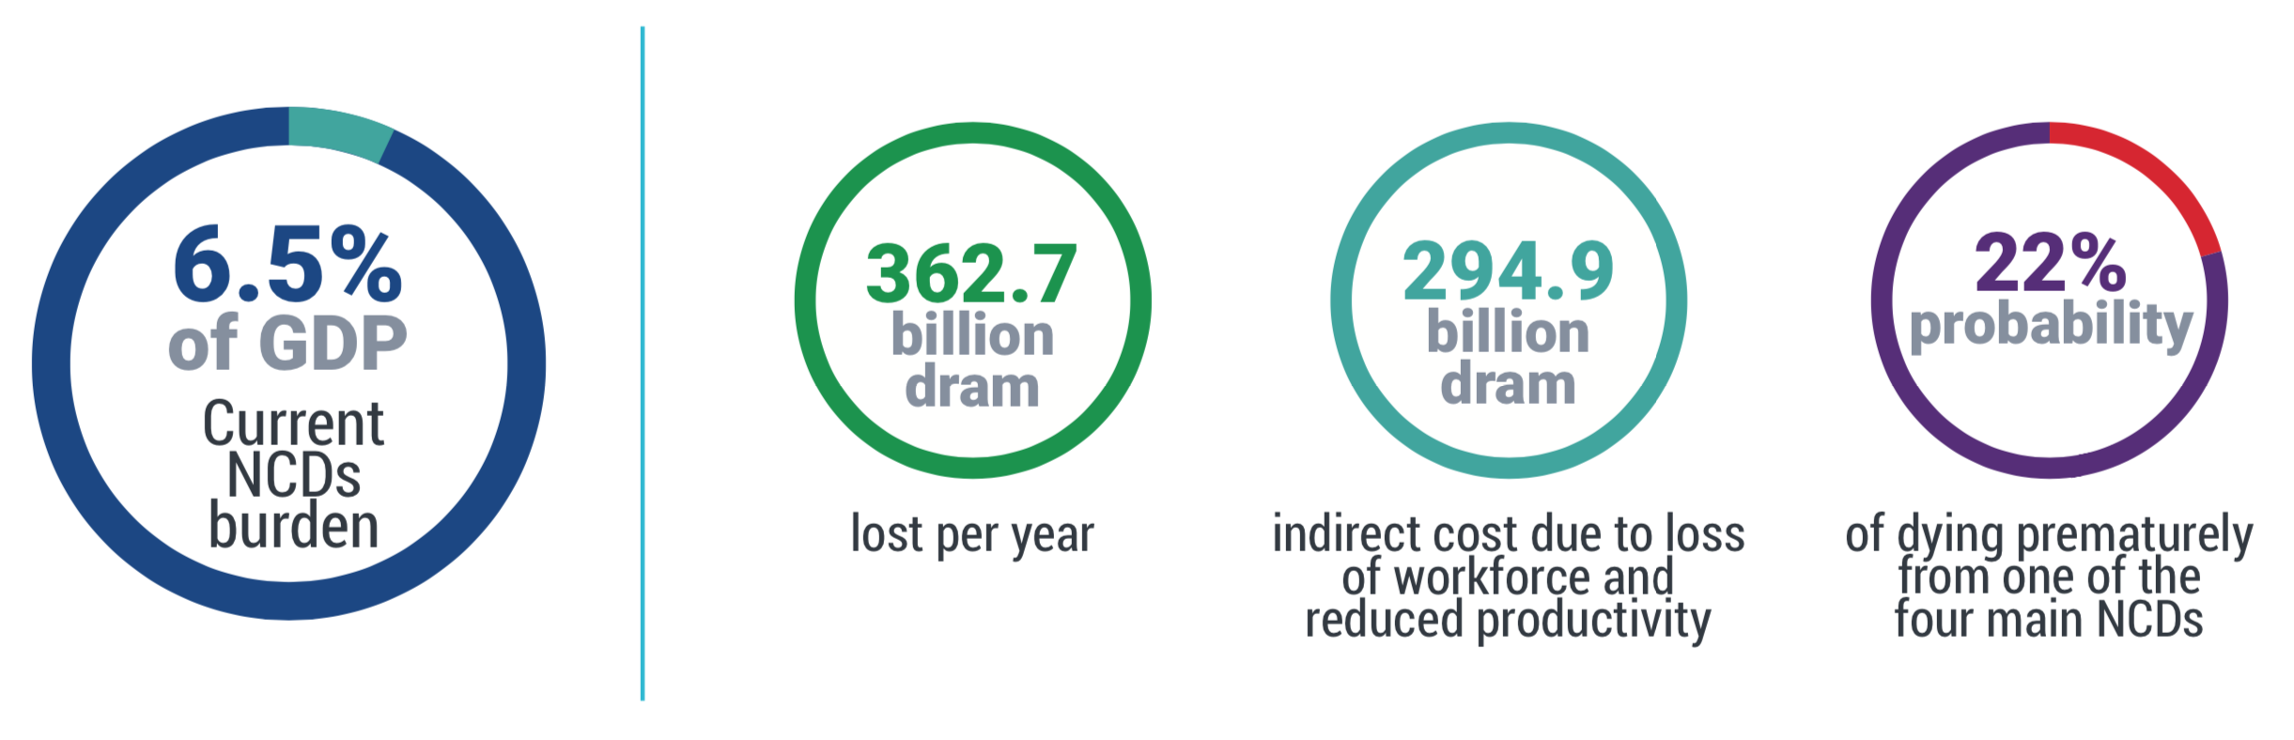
The burden on non-communicable diseases has a significant economic cost
Over 360 billion AMD estimated annual productivity losses due to spending, disability and premature mortality
Source: World Health Organization, 2017

Slide 9
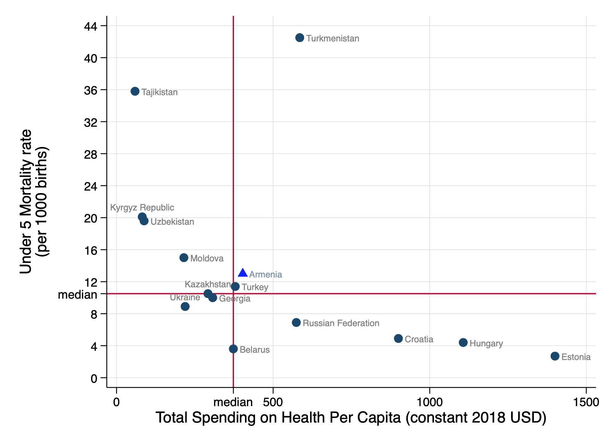
Need to identify opportunities to improve allocative efficiency of the HBP and access to NCD care
9

Slide 10





Health Interventions Prioritization Tool (HIPtool)
Developed to provide technical assessments that can support resource allocations' prioritization in national benefits packages
Draws on multiple data sources: Disease burden, health spending, intervention coverage, effectiveness
Uses an optimization algorithm
Government information/datasets
Interventions
Costs
Coverage
Effectiveness
Burden
Local institutions/ evidence
Interventions
Costs
Coverage
Effectiveness
Burden

Slide 11
Broad steps to represent Armenia’s health services in HIPtool
Four challenges and solution approaches
Defining the “Armenia UHC” interventions
Estimating AUHC intervention need
Estimating current AUHC intervention coverage
Validation of estimates of AUHC intervention coverage
Calculation of total annual AUHC intervention spending and spending per person
Validation of the relationship between disease burden, spending, and impact
Defining equity and financial risk protection scores
Aggregation of model outputs for AUHC interventions by DCP3 package for mathematical optimization.

Slide 12
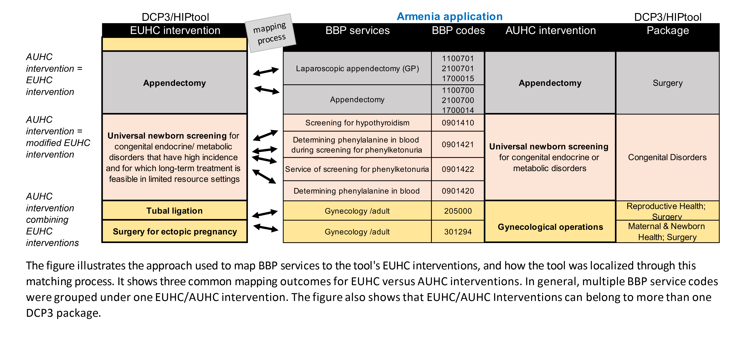
Challenge #1: Defining the AUHC interventions
– Mapping & cross-walking

Slide 13
Challenge #2: Global PHC capitation spending categories
- Disaggregation into AUHC interventions through triangulation
Capitation spends allocated across 9 AUHC interventions
Based on the estimated number in need, % covered, price and number of annual consultations or unit price
Also pulling in vaccine spend data for some interventions’ unit price calculation
Example:
HIP intervention | Eligible/ in need | Comments | Percentage coverage | Number of people covered | BBP codes unit price (calculated, in AMD) | Capitation/free-drug unit price (calculated, AMD) | TOTAL UNIT PRICE | BBP codes intervention spending (reported, in AMD) | Overall capitation spend
Detection and management of acute malnutrition in children and referral in the presence of complications | 29,120 | U5 stunting 9.4%, wasting 4.5%, over-weight 13.7%. U5s 208,000. Assume 14% in need. | 70% | 20384 | 0 | 4,572 (3 * 1,524 AMD est. child consultation cost) | 4,572 | - | 93,195,648

Slide 14
Challenge #3: Broad drug spending categories
- Apportioning to interventions (unit costs, estimations)
8 AUHC interventions were matched to HBP spending for “the provision of drugs for free for selected conditions at the PHC level”
7 AUHC interventions were matched to HBP spending for “the free provision of medication for selected conditions among children below 18 years of age”
Example:
HIP intervention | GBD causes addressed | Eligible/ in need | Comments | Beneficiary pop’n | Comments: coverage | Coverage | Est. number covered | Adjusted HIP unit cost | Est. unit cost (AMD) | Est. total (AMD)
Management of acute exacerbations of asthma and COPD using systemic steroids, inhaled beta-agonists, and, if indicated, oral antibiotics and oxygen therapy | COPD; Asthma: | 1,905 | NIH: COPD/Emphysema 2,840 in care, Asthma 4778 = 7,618 (assume 20% in need) | SVSG, Emergency | Assume 80% of eligible receive intervention | 80% | 1,524 | 258.38 | 90,000 | 122,839,189

Slide 15
Outcome of intervention & spending mapping
135 defined AHIP interventions with specified eligibility, coverage and unit prices
Aggregated and set into the overall spending context

Slide 16
Challenge #4: Disease burden – spending –impact relationship
- Review of saturations, revision of inputs
        All pre-populated ICER values were updated to 2019 values. A default 30% reduction was applied to all ICERs given reaI-life service delivery conditions
For 27 of the 135 AUHC interventions, this relationship showed up as problematic
Causes are the incomplete linkage of all the disease burden the intervention could address, or the CE of the intervention being too low
Solutions:
        Better linkage of all relevant burden (as per GBD causes targeted)
        Identification of an alternative, valid ICER which was higher than the pre-populated ICER
        Last resort (3 interventions), was editing the burden estimate
        For example, for C5, the burden of disease was revised to 10 DALYs from 1 DALY.

Slide 17
SCENARIO 1:
Realistic vs. optimal intervention coverage increases
Health gains to optimizing resource allocations within the 2019 budget
Compared a model that placed limits on potential increases in intervention coverage (limited intervention coverage increase) to a model that did not limit potential increases in intervention coverage (unlimited intervention coverage increases)
For limited intervention coverage increase, the rise in intervention coverage was restricted to 10%, considered realistic for programmatic scale-up of an intervention over 1-year
Equal weights given to cost-effectiveness, equity, financial risk protection
17

Slide 18
Scenario 1: Spending results
Consistently highest allocations for CVD package
Consistently largest %-increases in spending for musculoskeletal and cancer packages
Palliative care package gained 44% in spending in the limited coverage increase option
2019 spending
Optimized spending
(Limited intervention
coverage increase)
Optimized spending
(Unlimited intervention
coverage increase)

Slide 19
Scenario 1: DALY impact
2019 baseline: 120,000 averted DALYs
Limited coverage increase: 9% higher DALY impact
Unlimited coverage increase: 26% higher DALY impact
Packages without increasing spending can gain impact through internal re-allocations in a package’s interventions
Number of DALYs averted
2019 DALYs averted
Optimized (Limited
intervention
coverage increase)
Optimized (Unlimited
intervention
coverage increase)

Slide 20
SCENARIO 2:
2019 versus Increased budget
Implications of a hypothetical higher budget, that was funded at 37.9% above the 2019 level for optimizing allocations
Higher budget decided in discussion with the Ministry of Health as a hypothetical increase of the allocation to health from 5.8% to 8.0% of the 2019 state budget
No limits to potential increases in intervention coverage
As in Scenario 1, equal weights were given to cost-effectiveness, equity, and financial protection
20

Slide 21
Scenario 2: Spending results
Again consistently highest allocations for CVD package
At both budget levels, optimization prioritized the packages for surgery, musculoskeletal disorders, cancers
With the higher budget, additional packages were scaled-up: mental health, palliative care, pandemic interventions, rehabilitation
Millions

Slide 22
Scenario 2: DALY impact
Compared to the optimized 2019 budget, optimized allocations within the higher budget averted an additional 15,000 DALYs
At the higher budget, all but one package (adult febrile illness) had higher averted DALYs than under the optimized 2019 budget
The higher budget, allocated optimally, averted an additional 38.7% DALYs above the 2019 actual allocations
Number of DALYs averted
2019 DALYs averted
Optimized
DALYs averted
(2019 budget)
Optimized
DALYs averted
(higher budget)

Slide 23
SCENARIO 3:
Differential weights in optimization algorithm
Health gains to optimizing resource allocations within the 2019 budget by varying the weights given to cost-effectiveness (CE), equity and financial protection in the optimization formula
“CE-focused model”: 0.80 : 0.10 : 0.10 weighing (not equal 0.33)
Allowable intervention coverage increase limited (short-term scale-up)
      FINANCIAL RISK PROTECTION: SCORES 1-6
      1-5 points based on local unit price, 1 point if expenditure likely recurrent beyond 1 year
      Lowest price band <3,000 AMD, highest band 180,001+ AMD
      EQUITY: SCORES 1-3
      Highest score pregnant/ lactating women, children, disabled populations, populations with poverty-related diseases such as malnutrition and TB
      Lowest score for general population
23

Slide 24
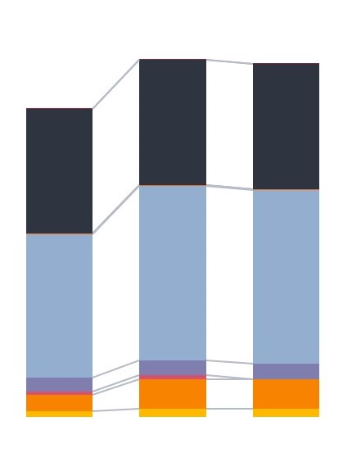
Scenario 3: Spending results & DALY impact
EXAMPLE CANCER PACKAGE: Childhood cancer allocation dependent on weights in model
2,000
1,800
1,600
1,400
1,200
1,000
800
600
400
200
0
16,000
14,000
12,000
10,000
8,000
6,000
4,000
2,000
0
Spending
DALYs averted
Millions
2019 DALYs averted
Equal
weights
model
CE
focused
2019 DALYs averted
Equal
weights
model
CE
focused

Slide 25
Conclusions (1)
Lesson 1: Increase relative funding for high-impact interventions
CVD package addresses very high current and projected burden and received most funding in optimization
Higher funding for the highly cost-effective interventions in the musculoskeletal and cancer packages recommended
Optimizing resource allocations within the 2019 budget averted up to 30,000 extra DALYs

Slide 26
Conclusions (2)
Lesson 2: Increase public spending on health
Analysis illustrated how the limited public spending on health available restricts investments in cost-effective interventions, which target prioritized groups
With a 40% higher budget, additional funding was allocated to CVDs, surgery, mental health palliative care, rehabilitation, and pandemic management
The budget increase translated to an additional 15,000 DALYs averted compared to the optimization of the 2019 budget

Slide 27
Conclusions (3)
Lesson 3: Pool spending on the HBP and vertical programs
Study pooled spending on the HBP with funding for vertical programs funded through development partners (Gavi, GF)
Explored possibilities for improving health spending efficiency post-health financing transition, when country has increased autonomy over spending priorities
Optimizing allocations led to significant increases to funding for the TB package and immunization interventions indicating where further value-for-money could potentially be gained

Slide 28
Conclusions (4)
Lesson 4: Implement structured and consultative benefit package revisions
Modeling can inform HBP revision in the short-term, despite limitations of the tool and available evidence
Known key elements to a structured and consultative process for HBP revision (ex. Thailand)
Legal documents describing the HBP revision steps will strengthen the process

Slide 29
Conclusions (5)
Lesson 5: Strengthen strategic purchasing mechanisms
Purchasing decisions not strategically linked to quality, efficiency
Limited attention to quality in benefits specification, provider selection, payment and monitoring service provision
Recommend that revisions to the HBP increasingly use an evidence-based, participatory, systematic process for value-for-money

Slide 30

Thanks!

