Slide 1
Value-Based Pricing: Potential & Considerations in LMICs
Dan Ollendorf, PhD
Director, Value Measurement & Global Health Initiatives
Center for the Evaluation of Value & Risk in Health

Slide 2
Disclosures
Under contract to IDB on unrelated opportunity cost project
Some information sourced from The Right Price: A Value-based Prescription for Drug Costs (ISBN 978-0197512876)
No other financial conflicts with presentation content

Slide 3
Agenda
Basic principles of cost-effectiveness analysis and value-based pricing
Formalized health technology assessment and the value connection
Implementation of value-based pricing and implications for low- and middle-income settings

Slide 4
Cost-effectiveness analysis and value-based pricing

Slide 5
What does “Value” Mean in Health?
How has the notion of value evolved?
Relationship of price of goods to their value or “utility” is nothing new
18th century “classical economics” focused on utility to society or distinct societal class
      E.g., Smith, Malthus
Utility to the individual has been discussed for millennia, dating back to ancient Greeks (e.g., Epicurus)
Formal school of thought first proposed by Bentham in early 1800s

Slide 6
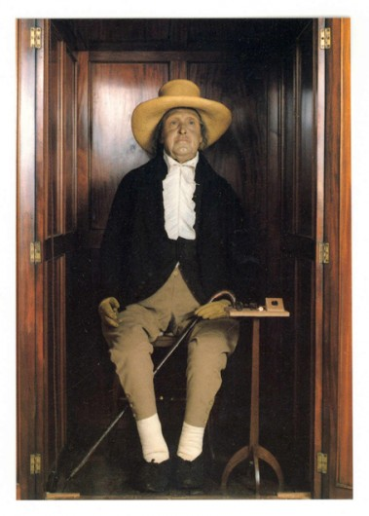
Bentham’s Principles
Individual right to choose based on what is best for that individual
Welfare of an individual does not depend on that of any other
Societal welfare is the sum of individual utilities
Each individual carries equal weight in collective decisions
Free-market competition improves welfare only under conditions of equal opportunity
Utility can be quantified

Slide 7
“Valuing” our Health
Standard gamble: choice between certain outcome and gamble for better one (e.g., current heart failure vs. probability of cure)
Time tradeoff: choice between value of two certain outcomes (e.g., X months of perfect health equivalent to Y months in poorer health state)
Rating scales: categorical, magnitude estimation, equivalence, willingness-to-pay
Sources: general public, patients, caregivers

Slide 8
From Utility to the QALY
The “quality-adjusted life year”
Created to adjust future years of life for their quality
Measured on a scale of 0 (dead) to 1 (perfect health)
Driven by utilities, e.g.:
      10 years of perfect health (10 X 1) + 5 years at utility 0.75 (5 X 0.75) = 10 + 3.75 = 13.75
  Simple but not without controversy:
      “You are valuing my life less than another”…

Slide 9
Cost-Effectiveness: “Value for Money”
Source: Hepatitis C online. Cost and Access to Direct-Acting Antiviral Agents. https://www.hepatitisc.uw.edu/pdf/evaluation-treatment/cost-access-medications/core-concept/all

Slide 10
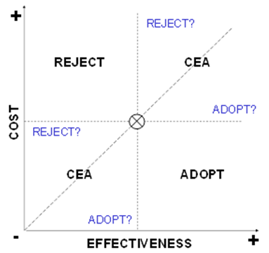
The Cost-Effectiveness “Frontier”
Source: Goodman C. HTA 101: Introduction to Health Technology Assessment. https://www.nlm.nih.gov/nichsr/hta101/ta10101.html

Slide 11
Health technology assessment and value

Slide 12
The Growth of HTA
Health technology assessment (HTA) as a discipline has also been around since the 1960s
Natural outgrowth of growing need to keep pace with technological innovation in health and other disciplines
And of course, to determine whether the benefits provided by the new innovation are “worth” the extra cost
HTA exists in every developed nation, but slower to gain traction in LMICs, where it is perhaps most needed

Slide 13
Key Components of HTA
Understanding of disease burden and epidemiology
Critical review of clinical evidence
      Including meta-analysis or other quantitative synthesis
  Economic impact
      Cost-effectiveness (most of the time)
      Budget impact
  Other considerations
      High unmet need or other priority area?
      Major change in practice?
      Improves patient access/convenience?
  Independent deliberation

Slide 14

How to tell if an investment is worth the cost?

Slide 15

The “right price” is the value-based price

Slide 16
Decision-making thresholds
Source: Cameron D, et al. Global Health Action 2018
DOI: 10.1080/16549716.2018.1447828

Slide 17


Is One Analysis Enough for an Entire Country?
Pneumococcal Conjugate Vaccine (PCV) in the Philippines
Stakeholder Preferences
Group | Vaccine A 15% less effective | Vaccine B 40% more expensive
Patients/Citizens
Marginalized Communities
RECOMMENDED:
Vaccine A
https://hta.doh.gov.ph/2020/10/26/reassessment-of-10-versus-13-valent-pneumococcal-conjugate-vaccines-pcv-in-the-philippines/
Notes:
There in fact are things that HTA organizations can do and are doing. Our first example comes from the Philippines, and involves consideration of equity as part of recommendation making.
[CLICK]: The topic was the pneumococcal conjugate vaccine, which can prevent sometimes very serious pneumonia and meningitis. There were two vaccine types discussed, which I’ll call “A” and “B”.
[CLICK]: The results of the formal value assessment indicated that Vaccine A is somewhat less effective than vaccine B, while B is more expensive. The Philippine HTA agency then shared this information with two important groups, patient and citizen advocates as well as leaders of marginalized communities, and surveyed them to understand their preferences for the two vaccine types.
[CLICK]: The patient/citizen group expressed a preference for B before they understood that the health budget impact would preclude its use in all vaccine candidates.
[CLICK] After this information was shared, they opted for A instead.
[CLICK]: Similarly, leaders of marginalized communities understood that vaccine effectiveness is not only a function of how well it prevents disease but also who can access it – in other words, is it giving everyone their fair shot (no pun intended) at a meaningful health gain?
[CLICK]: This had a major impact on HTA deliberations, which ultimately recommended the less cost-effective but more equitable choice.
[CLICK]

Slide 18
Value-based Pricing in LMICs:
History and Considerations

Slide 19
Value Assessment in LMICs
Benefit package design/redesign
Adoption of individual technologies

Slide 20
Benefit Packages
Source: Ochalek J et al. BMJ Global Health 2018; DOI: 10.1136/bmjgh-2017-000607
Notes:
Also mention Ethiopia revision of ESHP, based first on ICERs, then adjusted based on equity/FRP considerations

Slide 21
Technology Adoption
Do LMICs need to conduct value assessments of individual drugs or other technologies?
Other examples:
      Preventive cardiology Rx in Tanzania, all risk levels
      Diabetes screening in Thailand/Indonesia, starting age 15
      Universal pre-employment drug testing, Bhutan

Slide 22
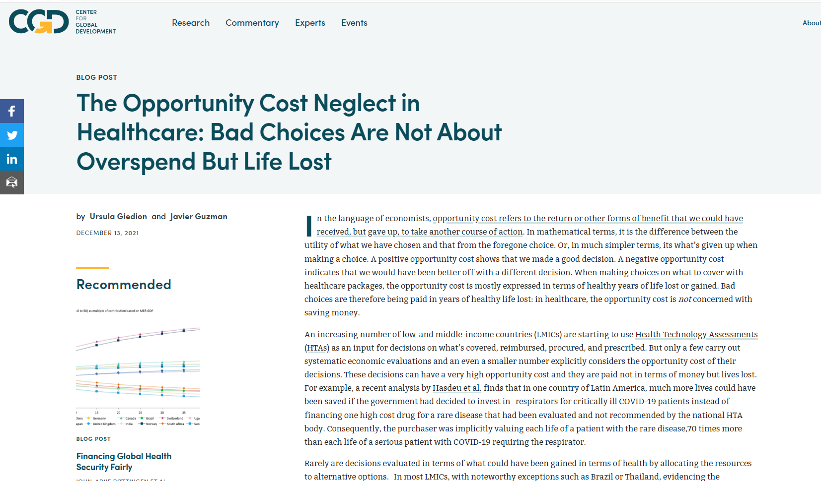
Implications of NOT using Value-based Pricing

Slide 23
Implications of NOT using Value-based Pricing
External or international reference pricing
Price convergence over time ignores individual country ability to pay
Systems can be “gamed”:
      Launch delays in lower-priced countries
      Market exits in unprofitable countries
      Raise list prices, keep discounts confidential
Value constructs and technical aspects (e.g., comparators, implementation) imported from abroad

Slide 24
Value-based Pricing in LMICs:
Recommendations

Slide 25



Value-based Pricing: Where to Begin?
If formal HTA already in place, can CEA activities be integrated?
If CEA can be integrated, can a relevant value threshold be set?
Without HTA and/or CEA, are there other sources that could speak to potential cost-effectiveness of new drugs?

Slide 26
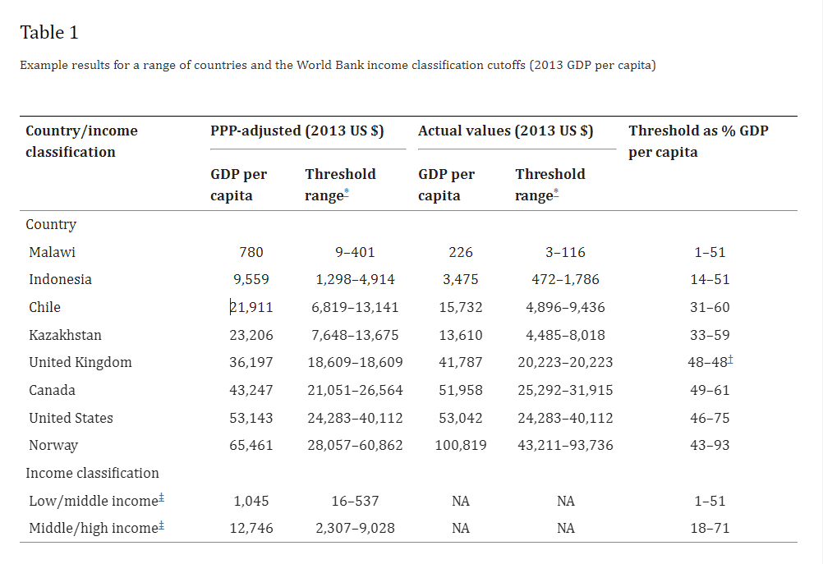
Threshold-setting Guidance
Based on relationship of local health spending to health outcomes, income elasticity of demand for health, and country income
Woods B et al. Value Health. 2016 Dec; 19(8): 929–935.

Slide 27
Value-based Pricing Can be Differential
One global price runs risk of being too low or too high
Simple differential pricing based on proxy GDP per capita also risky
Benefits of value-based approach:
      Based on local willingness to pay
      Linked to health system budget
      Explicit consideration of opportunity costs of investment

Slide 28

How Could this Work Across Countries?
Chalkidou K, et al. Gates Open Res 2020, 4:16 (doi: 10.12688/gatesopenres.13110.3)

Slide 29
Summary

Slide 30
Summing it all Up
Purchasing that is blind to opportunity costs sacrifices lives and wastes money
Drug price controls that ignore local values may reduce access to true innovation
LMICs can consider value-based pricing and purchasing now, even without formalized HTA or CEA steps
Those with value frameworks in place may benefit from pooled procurement to increase efficiency

Slide 31

Thank you!
dollendorf@tuftsmedicalcenter.org
@dollendorf

