Slide 1
The future of health spending in Latin America and the Caribbean
JHU: Krishna D. Rao, Andres Vecino-Ortiz, Timothy Roberton, Caitlin Noonan, Angelica Lopez Hernandez.
Partners: Yvonne Nicole Flores, Paulina Giusti, Angela Vega Landaeta, Daniel Maceira, Carla Jorge Machado, Andrea M. Prado, Alafia Samuels, Claudio Mora, Augusto Portocarrero, Natalia Palacio, Augusto Portocarrero, Paula Ramirez Palacios, Marisol Torres Toledano, Clida Duque Molina, Althea La Foucade, Karl Theodore, Christine Laptiste, Vyjanti Beharry, Alen Jimenez
Acknowledgement: Diana Pinto, William Savedoff

Slide 2
Objectives
Johns Hopkins University, USA
Federal University of Minas Gerais, Brazil
Mexican Social Security Institute (IMSS)
INCAE Business School, Alajuela, Costa Rica
University of Buenos Aires, Argentina
Instituto de Analisis y Gestion (IAGes), Peru
University of the West Indies, Jamaica
Javeriana University, Colombia
Project objectives:
How current health expenditures (CHE) in LAC countries will change over the next 30 years.
Estimate effect of modifying NCD risk factors on the growth of CHE.
Estimate effect of controlling health care costs, moving towards universal health coverage on CHE growth.

Slide 3
Share of Health in GDP
Large variation in share of GDP spent on health (3.6% - 9.9%)
Several countries like Argentina, Brazil, Uruguay, and Chile spend at levels of high-income countries, but public spending relatively low in others (e.g. Mexico).
Public finance is important source of healthcare funds

Slide 4
Sources of Financing for Health
Many Latin American countries (e.g. Colombia, Costa Rica) have established social health insurance systems.
Caribbean countries (and Brazil) have largely adopted a National Health Service approach by financing health care primarily through general tax revenues.
Out-of-pocket expenditures on health have declined across the LAC region largely been due to increased government investments in health.
out-of-pocket spending continues to be an important source of financing health care

Slide 5
Growth in annual per capita health expenditure and annual per capita GDP(2010-2017)
Growth in health spending is a constant concern to governments.
Countries above the diagonal line face important concerns about their ability to afford growth in future health expenditures.
For countries below the diagonal line there are fiscal opportunities to expand spending on health given that increases in national income are outpacing health expenditures.

Slide 6
Future Health Expenditures

Slide 7
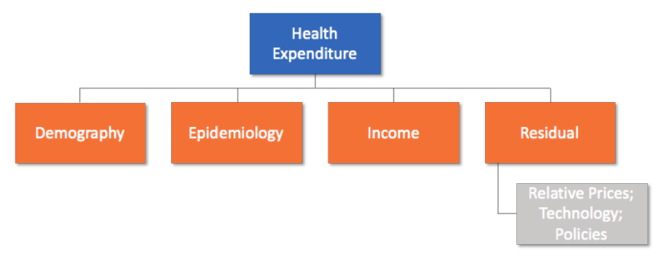
Generating base case expenditure projections to 2050
For a set of seven index countries (Mexico, Costa Rica, Argentina, Brazil, Peru, Colombia, Trinidad and Tobago), we obtained a baseline medical expenditure matrix for 2018 or 2019, with current health expenditure (CHE) disaggregated by age and disease categories
We developed a growth model for each country based on three factors:
Population growth and aging
Changes in prevalence of diseases
Economic growth and technology
For each country, we combined the growth factors and applied them to the baseline expenditure matrix to estimate future health spending, for each age and disease category, for the years 2020 to 2050
Notes:
Krishna’s talk showed the model
With the ongoing demographic and epidemiological transitions, and with developments in medical technology, health expenditure is likely to remain a considerable share of government spending in in the LAC region.

Slide 8
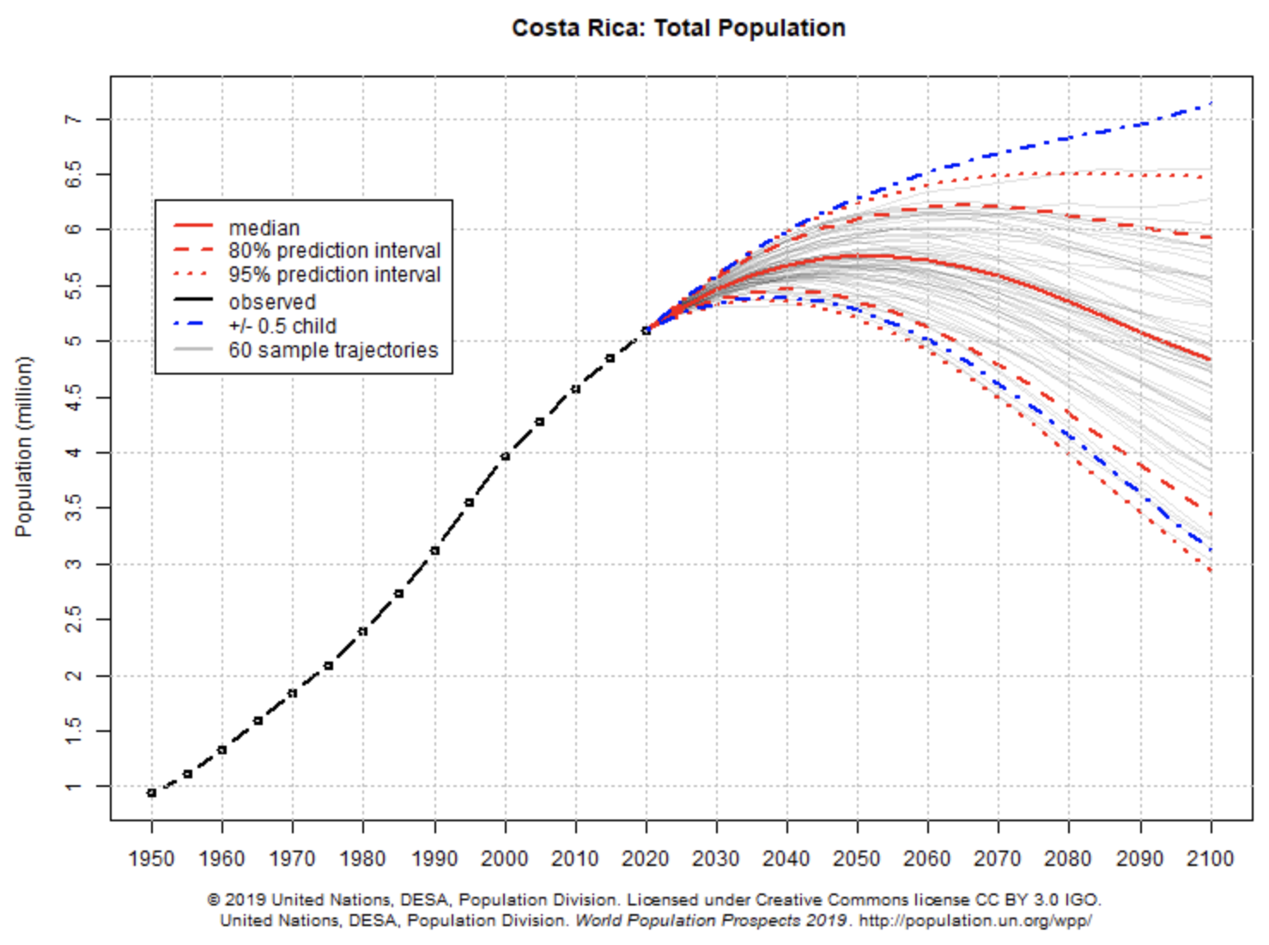
Factor 1 – Population growth and aging
Age-disaggregated population estimates from the United Nations World Population Prospects 2019
Five-year age categories
Used median values for the base case; 95% prediction interval for sensitivity analysis
Separated population growth from population aging:
Growth = change in the total population of a country
Aging = change in the distribution of the proportion in age categories

Slide 9
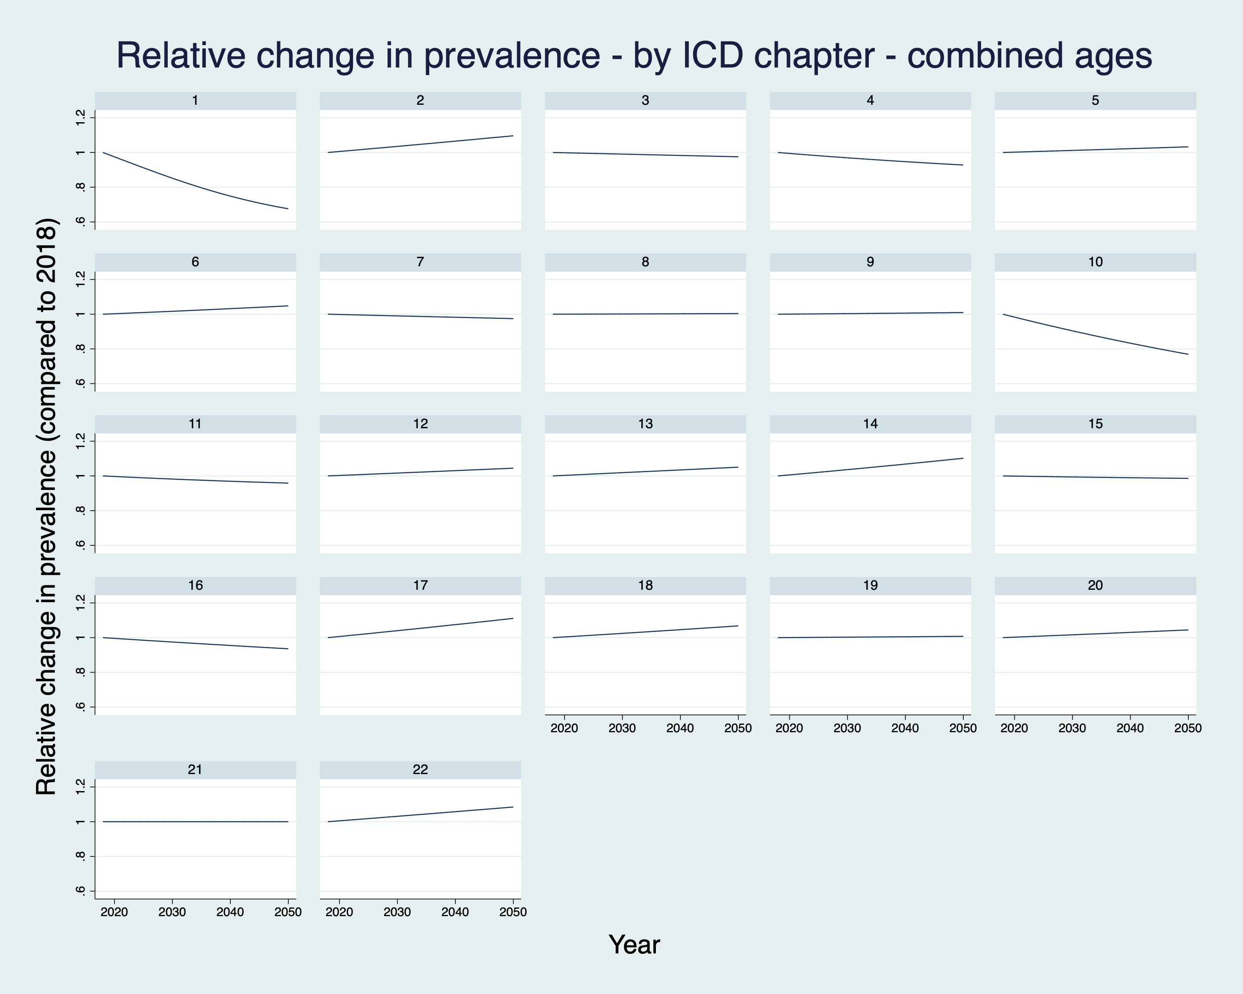
Factor 2 – Changes in prevalence of diseases
Historical prevalence estimates from IHME Global Burden of Disease (GBD) for 2000 to 2020
Used a linear model to project historical prevalence trends into the future, from 2020 to 2050
Base case, with 95% confidence estimates for sensitivity analysis
Data are five-year age and country specific prevalence for GBD conditions
Mapped GBD diseases to ICD10 chapters
In our model, we report “epidemiology”, combining age-specific prevalence, population growth, and population aging

Slide 10
Factor 3 – Economic growth and technology
For each country, estimated the “economic growth and technology” factor as the sum of:
the contribution of economic growth to current health expenditures
the contribution of a residual factor that includes increases in medical prices, the effects of introducing new technologies, the intensity of medical service use, changes in health service coverage and other factors.
Contribution of economic growth to current health expenditures based on income elasticity estimates derived from a fixed-effects regression analysis of historical expenditure in the region.
This residual factor estimated by subtracting the contributions of demographic change, disease prevalence, and economic growth from total health expenditure growth.
COVID-19: To account for the Covid-19 pandemic, we adjusted our projection for 2020 before returning to the regression trend rate.

Slide 11
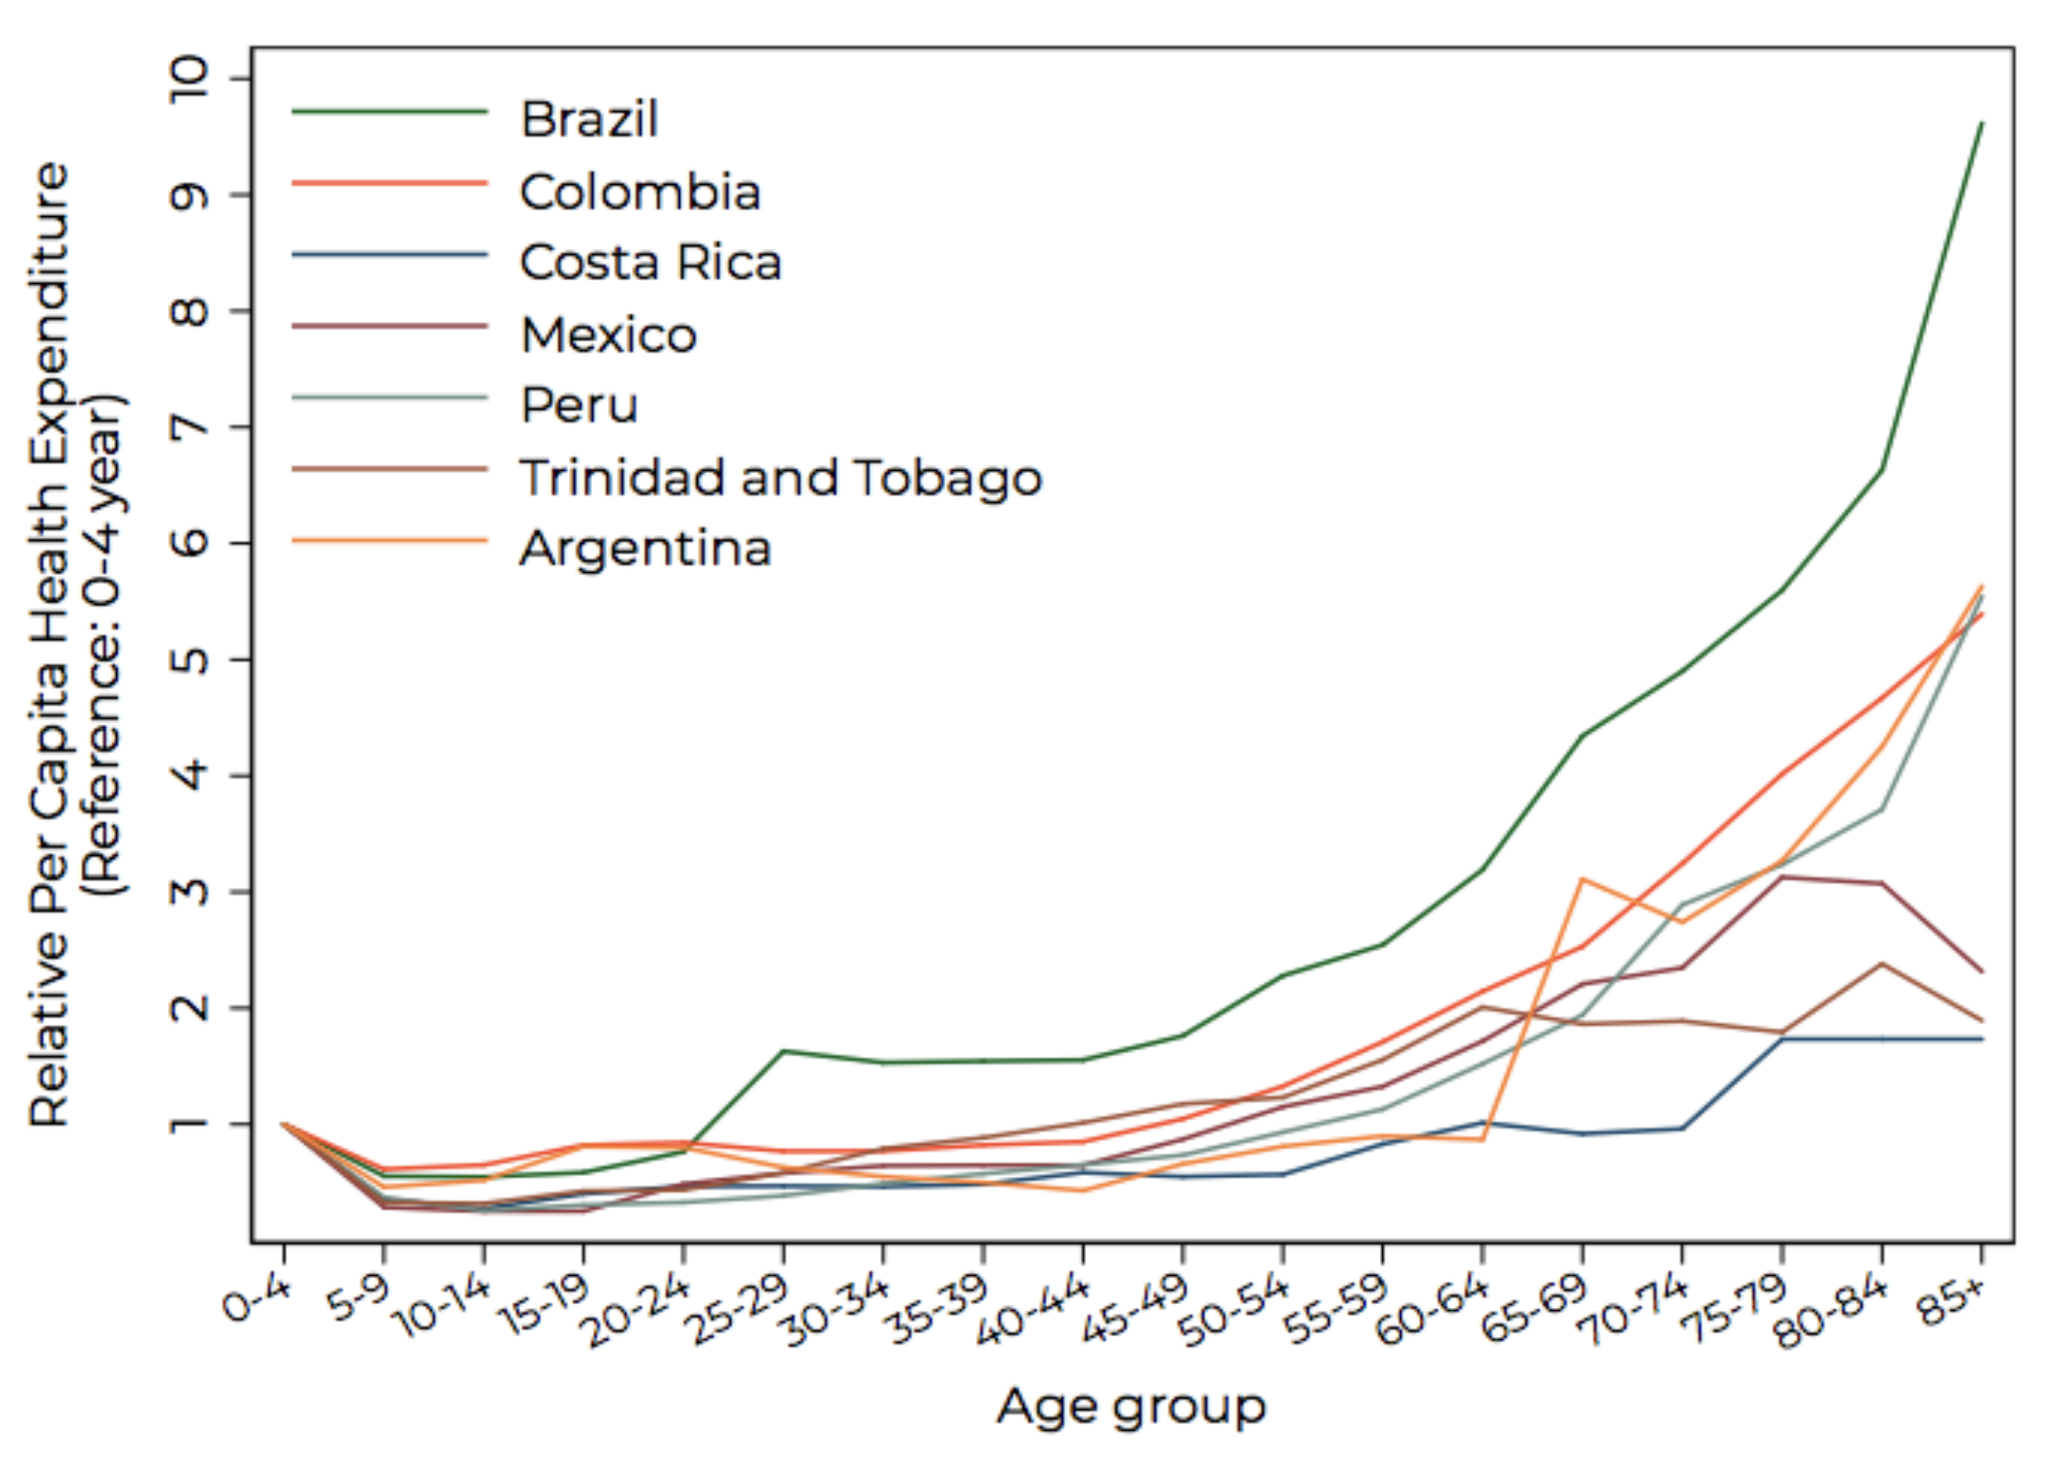
Extrapolating from index countries to the region
We grouped countries by their average per-capita health expenditures 2015-2018
To estimate a baseline expenditure matrix for each country, we assumed that the age-expenditure profile of the index countries represented those of other countries in each group
After estimating baseline expenditures, projections were based on country-specific changes in population, epidemiology, and economic growth and technology
Notes:
Latin America
Nicaragua, Honduras, Bolivia, Guatemala, El Salvador, Peru
Paraguay, Colombia, Ecuador, Mexico
Brazil, Costa Rica, Panama
Argentina, Chile, Uruguay
Caribbean
Guyana, Belize, Jamaica (Ref: Peru)
Suriname, Dominican Republic (Ref: Colombia)
Trinidad and Tobago, Barbados, The Bahamas

Slide 12
Annual growth in current health expenditure (CHE) per capita
Latin America
Caribbean
Note: Guyana results tentative and do not account for effect of expected oil revenues.

Slide 13
Share of CHE in GDP (2018/19-2050)
The share of health expenditures in GDP is projected to increase in all LAC countries except Guyana, though the extent of this increase is heterogenous.
The share of CHE in GDP is expected to nearly double in Belize, Guatemala, the Dominican Republic, Nicaragua, Jamaica, and Trinidad and Tobago
In some countries (Nicaragua, Brazil, Chile, and Argentina), the projected share of CHE in GDP is expected to approach 15% by 2050, which has important implications for affordability
Note: Guyana results tentative and do not account for effect of expected oil revenues.

Slide 14
Projected growth in GDP per capita vs projected growth in CHE per capita
*Guyana projections does not include effects of expected oil revenues.

Slide 15
Median annual growth rate of CHE by disease group (2018/19-2050)
Latin America
Caribbean

Slide 16
Median share of disease group in CHE (2018/19, 2050)
Latin America
Caribbean

Slide 17
Median annual growth rate of CHE by age (2018/19, 2050)
Latin America
Caribbean

Slide 18
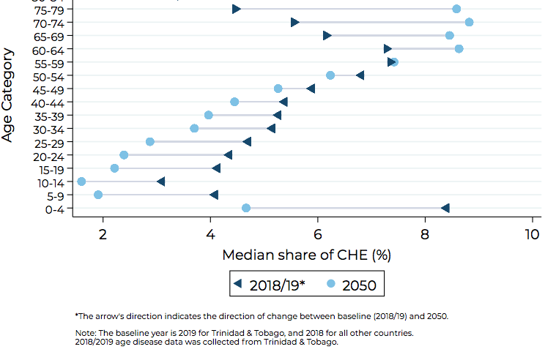
Median share of age category in CHE (2018/19, 2050)
Latin America
Caribbean

Slide 19
Contributors to Growth in CHE (2018/19, 2050)
Relative change in CHE from 2018/19 to 2050
Expenditure over time in LAC by contributing factor (2018/2019-2050)
Some countries diverge from the region-wide average findings of economic growth and technology being the main driver of CHE growth.
In Mexico, epidemiology and demography contributes an increase in CHE of 69.7%, followed by economic growth and technology (35.7%), and aging (32.6%)

Slide 20
Bending the expenditure curve

Slide 21
Scenario analysis
What opportunities exist to curb the projected growth in health expenditure?
We used the base case trends for each country to estimate:
Change in disease risk factors on non-communicable diseases
Four risk factors (tobacco use, hypertension, high blood glucose, alcohol use)
Five non-communicable diseases (cancer, diabetes, kidney failure, cardiovascular disease, COPD-chronic obstructive pulmonary disease)
Effect of cost containment policies
Expenditures required to achieve universal health coverage in 2030
Notes:
Cancer
Diabetes mellitus
Kidney failure
Cardiovascular disease
COPD-chronic obstructive pulmonary disease

Slide 22
Example: Estimating the effect of reducing tobacco use
Notes:
% attributable and prevalences of RF and diseases from IHME
%share of CHE from Colombian data

Slide 23
Other scenarios
Cost containment policies: Contribution of economic growth and technology for each LAC country adjusted using income elasticities of western European and high-income countries, where there is active negation between payors and providers over costs (e.g. Japan, France, Germany).
Cost to approach UHC: we used the Universal Health Coverage index based on the Global Burden of Diseases, Injuries, and Risk Factors Study 2019 from IHME, to determine the potential increase in CHE required to achieve a universal health coverage (UHC) index of 90 by year 2030, imputing the elasticity of UHC to CHE growth and assuming a linear trend.
Notes:
Linear because when assessing concave effects, we did not find statistically significant effects on the second-degree polynomial parameter.

Slide 24
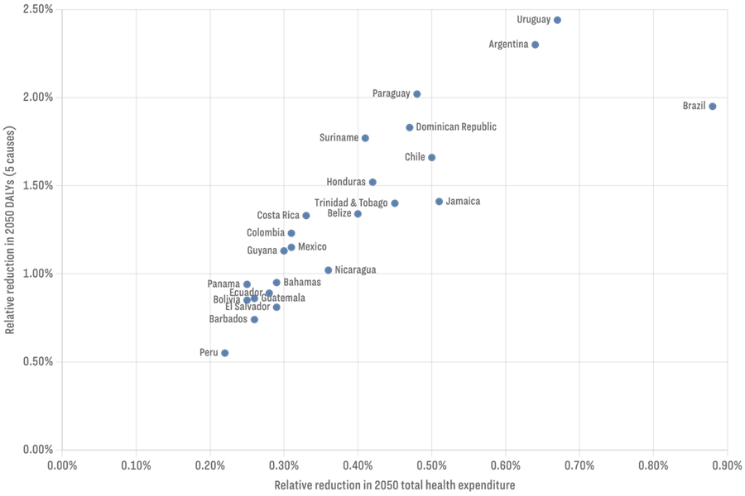
Effect of changes in prevalence of chronic conditions on expenditures and DALYs: TOBACCO.
The most important risk factor on reducing CHE for Brazil.
Countries with highest smoking prevalence benefit the most in terms of DALYs and CHE
Risk factor that we know how to address.
Notes:
Urugiua, Argentina, brazil, chile y paraguay

Slide 25
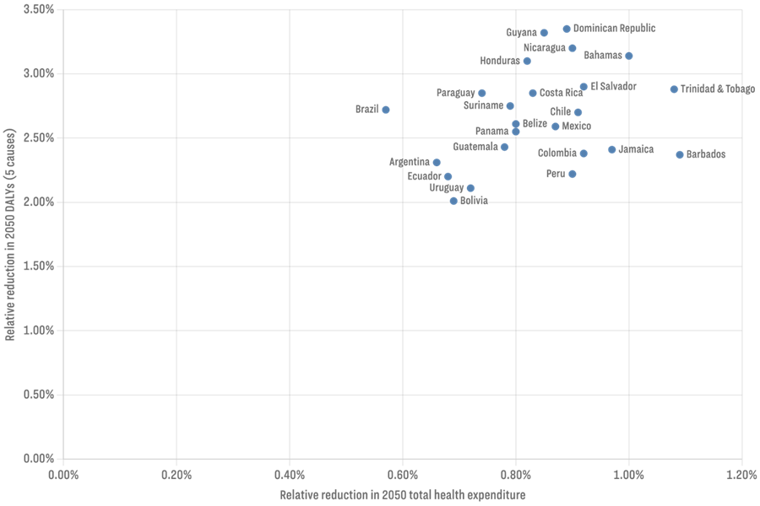
Effect of changes in prevalence of chronic conditions on expenditures and DALYs: HYPERTENSION.
The most important risk factor on reducing CHE for most countries.
Less variability across countries.
Risk factor difficult to address.

Slide 26
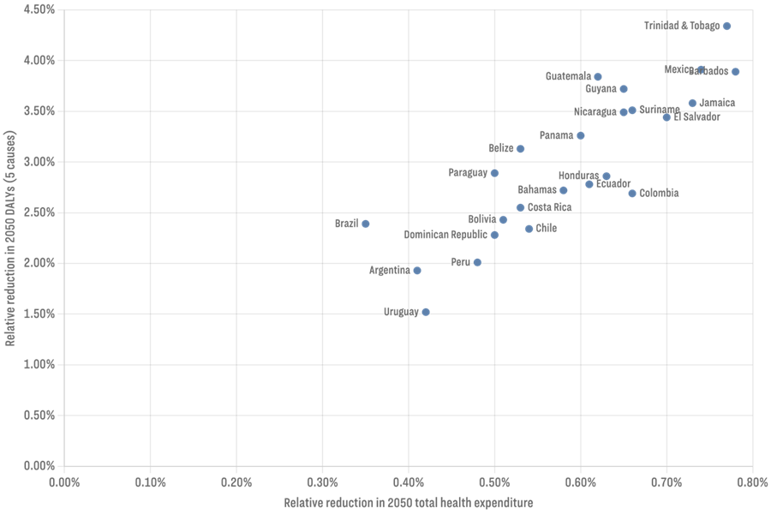
Effect of changes in prevalence of chronic conditions on expenditures and DALYs: HIGH BLOOD GLUCOSE.
Caribbean countries and Mexico benefit the most of curbing this risk factor.
High variability across countries.
Risk factor difficult to address.

Slide 27
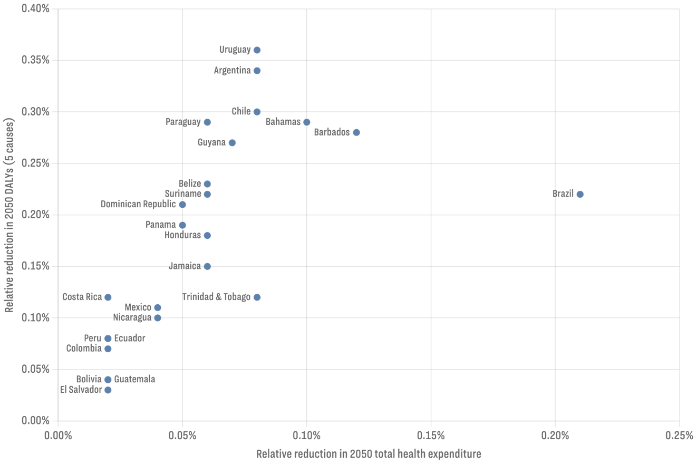
Effect of changes in prevalence of chronic conditions on expenditures and DALYs: ALCOHOL.
Risk factor with lower effects in terms of both CHE and DALYs.
Brazil as an outlier
Risk factor relatively easy to address.

Slide 28
Effect of cost control strategies on CHE in 2050.
Cost control is the most effective strategy to reduce CHE
High variability across countries
The level at which different countries benefit from cost-control is very country-dependent.
Notes:
Size, health system, inflation, income, use of technologies.
Reduction in 2050

Slide 29
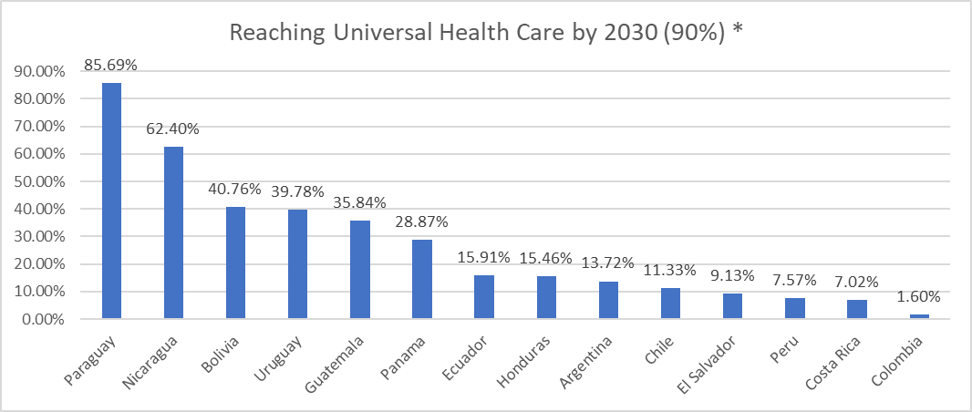
Investments needed to achieve a 90% UHC index in 2030.
Percent increases at which CHE needs to be increased from 2020 to 2030 in order to achieve UHC.
Countries closer to UHC require lower investments.
Smallest countries require higher percentual investments.
Brazil and Mexico were not measured, UHC at index equal to 90%

Slide 30
Summary
LAC region will experience real increases in CHE between baseline and 2050.
Affordability is a concern – by 2050 almost all LAC countries will experience health expenditure growth rates that exceed the growth in their national incomes.
Modest effects of changes in demography and epidemiology on increasing health expenditures; the main driver is economic growth and technology.
Shift in the distribution of health expenditures to chronic conditions and older ages.
To mitigate expected fiscal pressures consider strategies that ensure that future health resources are used more efficiently, pay attention to the health of older populations, and actively engage with cost control mechnisms.

Slide 31
Annex

Slide 32
Country groupings
In Latin America, four groups were formed (index countries in bold):
Group 1: Nicaragua, Honduras, Bolivia, Guatemala, El Salvador, Peru
Group 2: Paraguay, Colombia, Ecuador, Mexico.
Group 3: Brazil, Costa Rica, Panama
Group 4: Argentina, Chile, Uruguay
For the Caribbean countries, the following three groups were formed:
Group 1: Guyana, Belize, Jamaica (Reference profile: Peru)
Group 2: Suriname, Dominican Republic (Reference profile: Colombia)
Group 3: Trinidad and Tobago, Barbados, The Bahamas

